Slide 1


Lesson 1: Deploying and Managing Server Images
MOAC 70-411: Administering
Windows Server 2012

Slide 2
Overview
Exam Objective 1.1: Deploy and Manage Server Images
Using Windows Deployment Services
© 2013 John Wiley & Sons, Inc.
Notes:
Lecture notes go here

Slide 3
Using Windows Deployment Services
Lesson 1: Deploying and Managing Server Images
© 2013 John Wiley & Sons, Inc.
Notes:
Lecture notes go here

Slide 4
Windows Deployment Services (WDS)
WDS is a software platform and technology that allows you to perform automated network-based installations based on network-based boot and installation media.
The WDS server stores the installation files and helps you manage the boot and operating system image files used in network installations.
© 2013 John Wiley & Sons, Inc.

Slide 5
Preboot Execution Environment (PXE)
For client computers to communicate with a WDS server without an operating system, the client computer must support preboot execution environment (PXE).
When PXE is used with WDS, the client computer downloads a boot image that loads Windows Preinstallation Environment (Windows PE).
Windows PE is a minimal Windows operating system with limited services. Windows PE is then used to install the operating system using an operating system image file.
© 2013 John Wiley & Sons, Inc.

Slide 6
Installing the WDS Role
WDS is a server role included with Windows Server 2012. The WDS role includes the following two role services:
Deployment Server
Transport Server
© 2013 John Wiley & Sons, Inc.

Slide 7
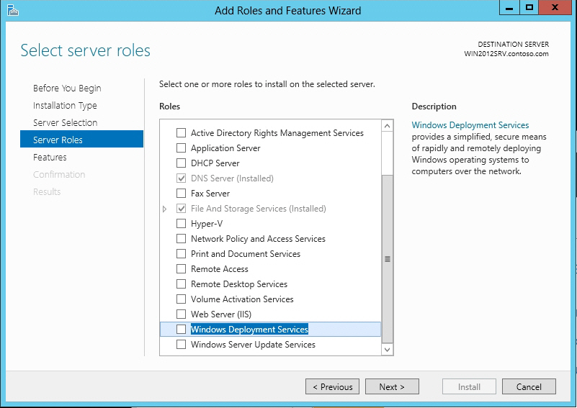
Deploy WDS
Selecting Windows Deployment Services
© 2013 John Wiley & Sons, Inc.

Slide 8
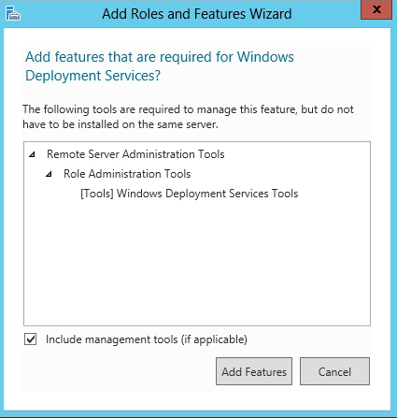
Deploy WDS-I
Adding required features for WDS
© 2013 John Wiley & Sons, Inc.

Slide 9
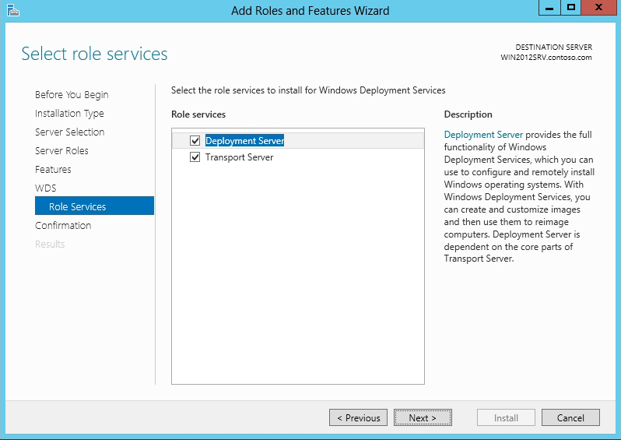
Deploy WDS-II
Selecting the WDS role services
© 2013 John Wiley & Sons, Inc.

Slide 10
Configuring the
WDS Server
To use WDS, your system must meet the following requirements:
• The server is a member of an Active Directory Domain Services (AD DS) domain, or a domain controller for an AD DS domain.
• There is an active DHCP server on the network.
• There is an active DNS server on your network.
• The WDS server has an NTFS file system partition to store images.
© 2013 John Wiley & Sons, Inc.

Slide 11
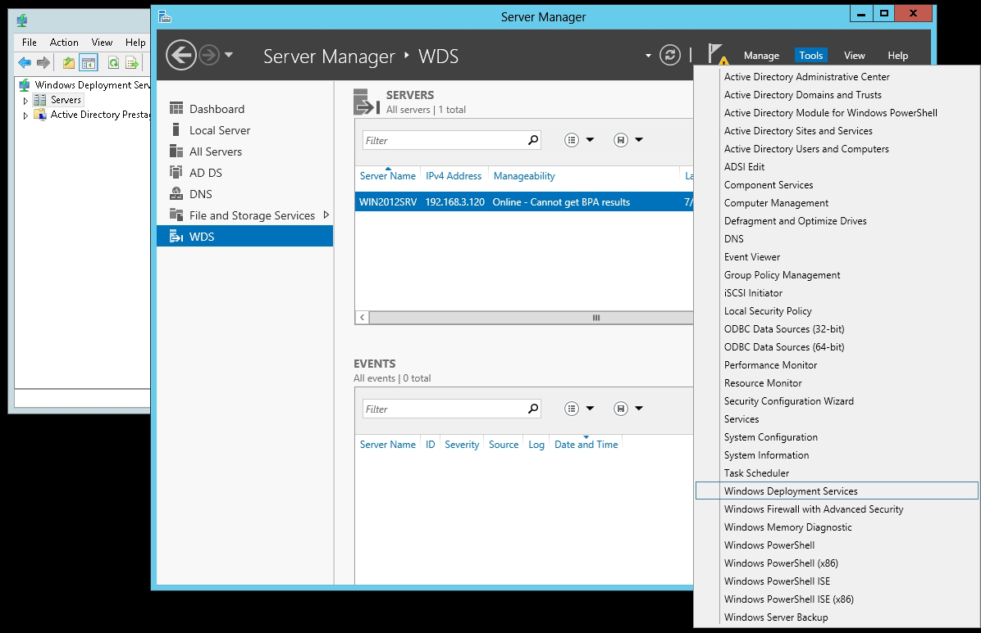
Perform the Initial Configuration of WDS
Opening the Windows Deployment Services console
© 2013 John Wiley & Sons, Inc.

Slide 12
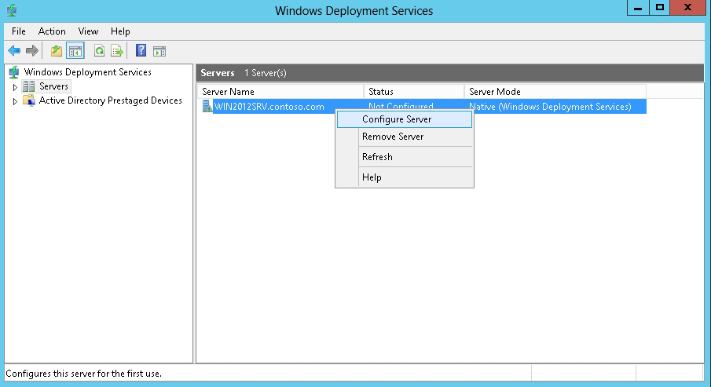
Perform the Initial Configuration of WDS-I
Starting the Initial Configuration Wizard for WDS
© 2013 John Wiley & Sons, Inc.

Slide 13
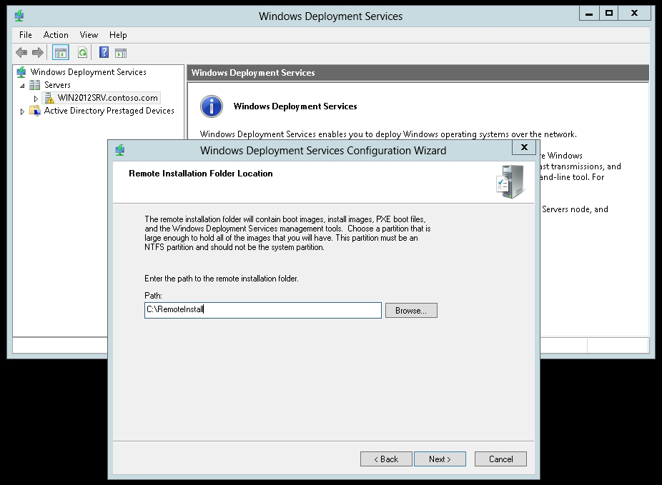
Perform the Initial Configuration of WDS-II
Specifying the location of the remote
installation folder
© 2013 John Wiley & Sons, Inc.

Slide 14
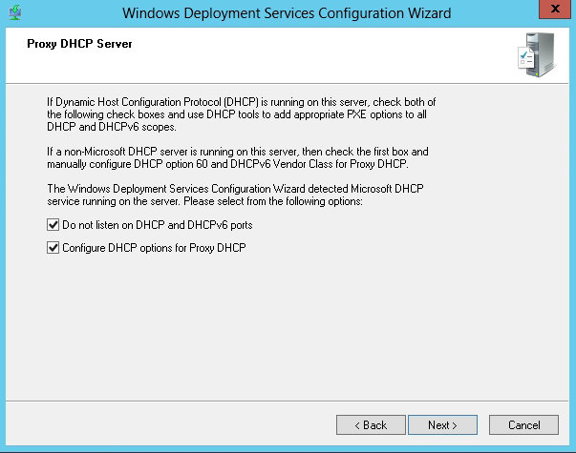
Perform the Initial Configuration of WDS-III
Specifying the DHCP Server options to work with WDS
© 2013 John Wiley & Sons, Inc.

Slide 15
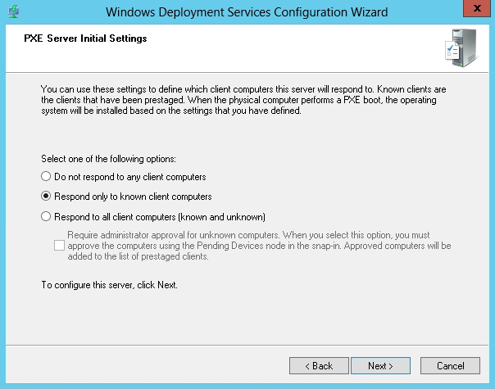
Perform the Initial Configuration of WDS-IV
Specifying how WDS/PXE server responds to clients
© 2013 John Wiley & Sons, Inc.

Slide 16
Configuring the WDS Properties
After the initial configuration, you must reconfigure the WDS server by accessing the WDS Properties.
Right-click the server in the Windows Deployment Services console and then select Properties.
© 2013 John Wiley & Sons, Inc.

Slide 17
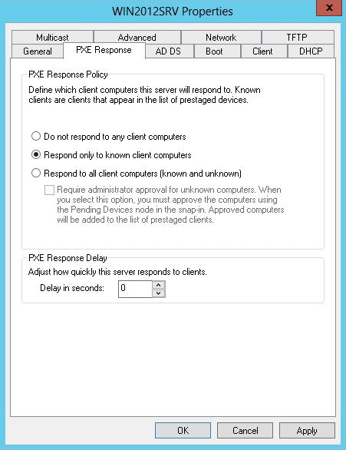
WDS Server Properties
The PXE Response tab
© 2013 John Wiley & Sons, Inc.

Slide 18
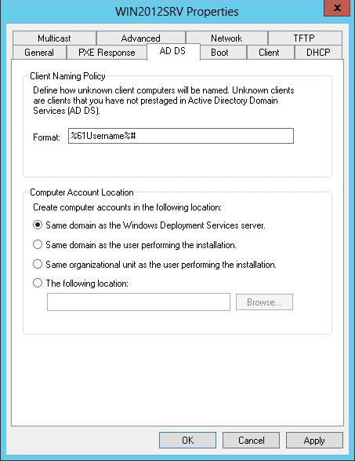
WDS Server Properties-I
The AD DS tab
© 2013 John Wiley & Sons, Inc.

Slide 19
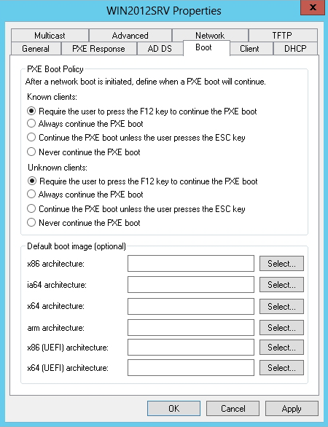
WDS Server Properties-II
The Boot tab
© 2013 John Wiley & Sons, Inc.

Slide 20
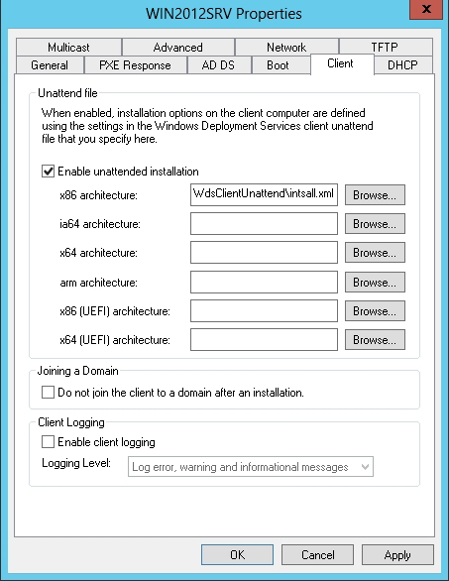
WDS Server Properties-III
The Client tab
© 2013 John Wiley & Sons, Inc.

Slide 21
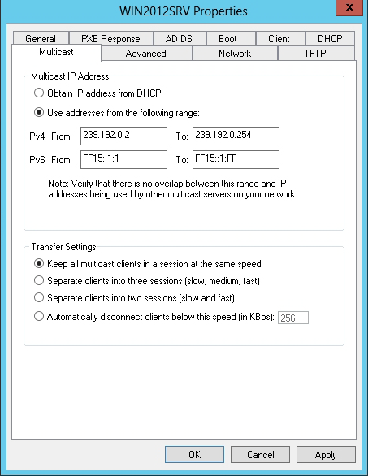
WDS Server Properties-IV
The Multicast tab
© 2013 John Wiley & Sons, Inc.

Slide 22
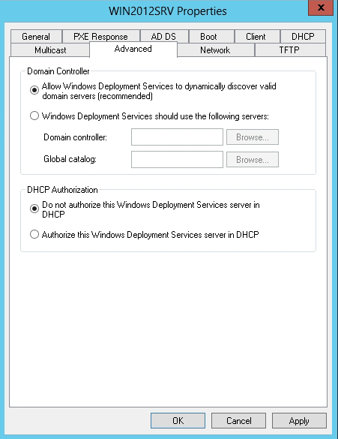
WDS Server Properties-V
The Advanced tab
© 2013 John Wiley & Sons, Inc.

Slide 23
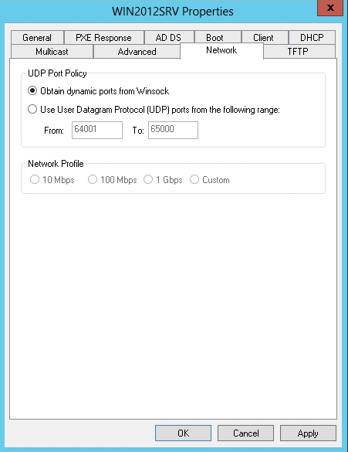
WDS Server Properties-VI
The Network tab
© 2013 John Wiley & Sons, Inc.

Slide 24
Configuring the Custom DHCP Option
If you have a separate server running DHCP server, you must manually configure it to include the custom option that provides the WDS clients with the name of the WDS server via DHCP.
If this option is not performed, the WDS clients will not be able to find the WDS server to boot from.
© 2013 John Wiley & Sons, Inc.

Slide 25
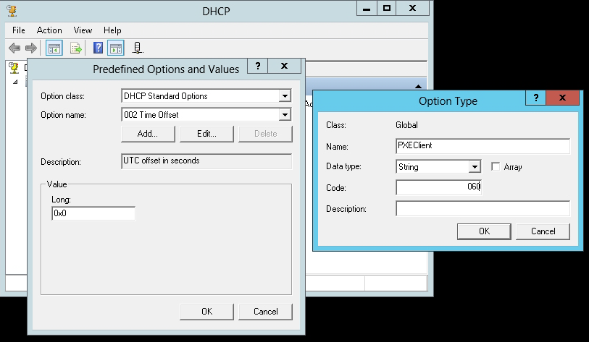
Configure the Custom
DHCP Option
Setting option types and specifying the PXE Client Option 60
© 2013 John Wiley & Sons, Inc.

Slide 26
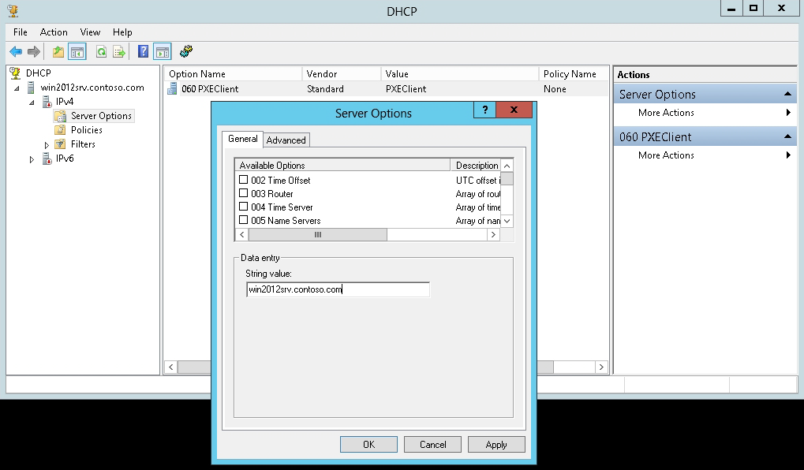
Configure the Custom
DHCP Option-I
Typing the name of your WDS server
© 2013 John Wiley & Sons, Inc.

Slide 27
Managing Boot, Install, and Discover Images
Two types of image formats:
  Sector-based image formats
  File-based image formats
The boot images and install images use the Windows Imaging Format (WIM).
WIM is a file format that allows a file structure (folders and files) to be stored inside a single WIM database.
© 2013 John Wiley & Sons, Inc.

Slide 28
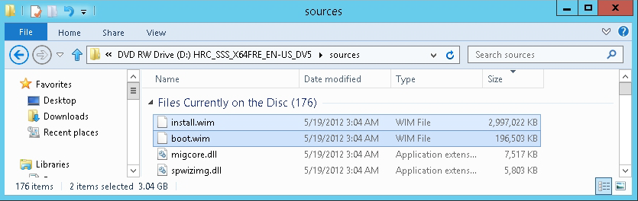
Adding Boot Images
Viewing the sources folder
© 2013 John Wiley & Sons, Inc.
Notes:
The Windows Server 2012 installation DVD includes a boot image file named boot.wim, located in the \sources folder.
The boot.wim file loads Windows PE 4.0 on the client computer.

Slide 29
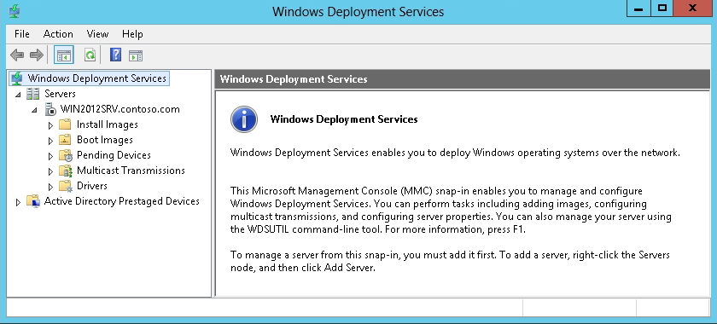
Add a Boot Image
Viewing the Install Images folder and the
Boot Images folder
© 2013 John Wiley & Sons, Inc.

Slide 30
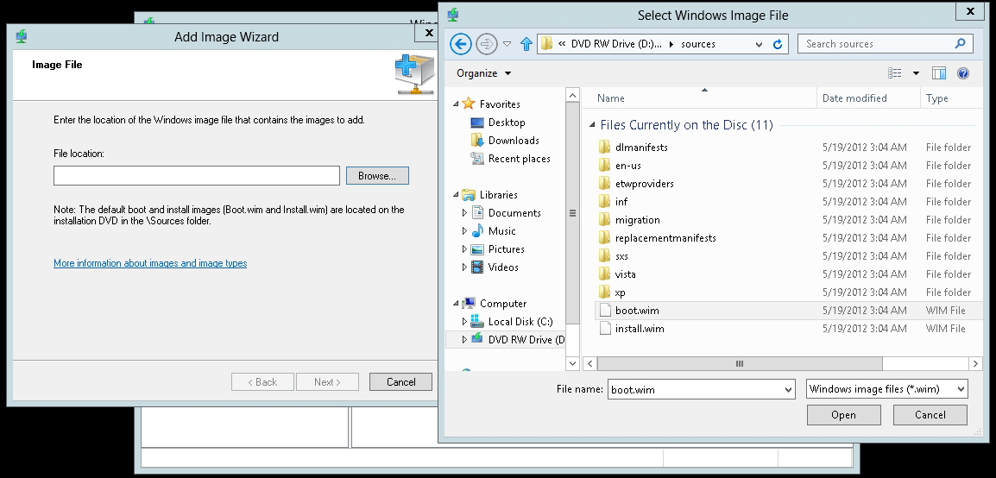
Add a Boot Image-I
Opening the boot.wim file
© 2013 John Wiley & Sons, Inc.

Slide 31
Adding Image Files
When you create image files, you place the image file in an image group.
An image group is a folder within the image repository of WDS that shares security options and file resources. The image group consists of:
  The resource .wim file (Res.rwm)
  The <imagename>.wim files
Any permission assigned to an image group is inherited by all the images in the group.
© 2013 John Wiley & Sons, Inc.

Slide 32
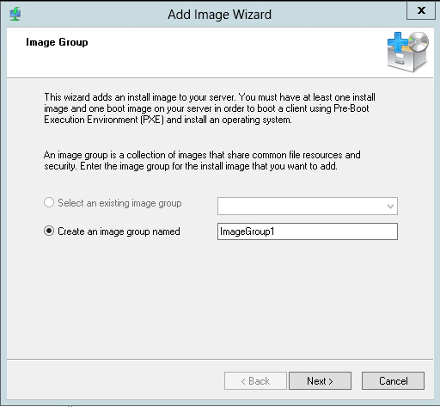
Add an Install Image File
Creating an image group
© 2013 John Wiley & Sons, Inc.

Slide 33
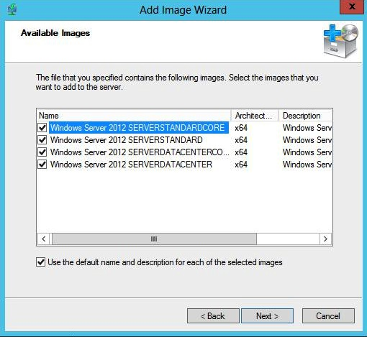
Add an Install Image File-I
Specifying the images you want to include
© 2013 John Wiley & Sons, Inc.

Slide 34
Creating an Image File with WDS
An image file contains:
All operating system files on the computer
Any updates and drivers that have been applied
Any installed applications
Any configuration changes that have been made
© 2013 John Wiley & Sons, Inc.

Slide 35
Creating an Image File with WDS-I
The install images included on a Windows installation disk are images of a basic Windows installation, with no patches, updates or additional drivers.
To create your own image files:
  Set up a master computer with all patches, drivers, applications, and configurations applied.
  Use WDS to create your own image file by modifying an existing boot image, booting the master computer with the modified boot image, and running the Windows Deployment Services Capture Utility.
© 2013 John Wiley & Sons, Inc.

Slide 36
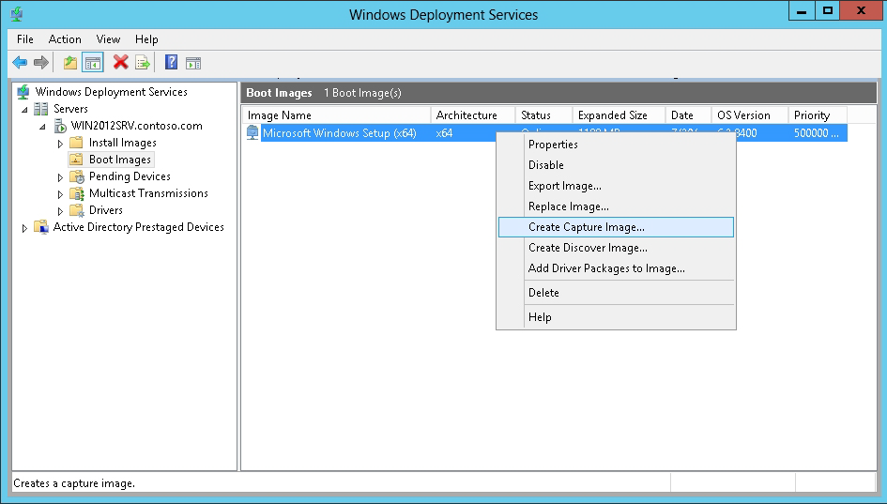
Create an Image File
Starting the Create Capture Image Wizard
© 2013 John Wiley & Sons, Inc.

Slide 37
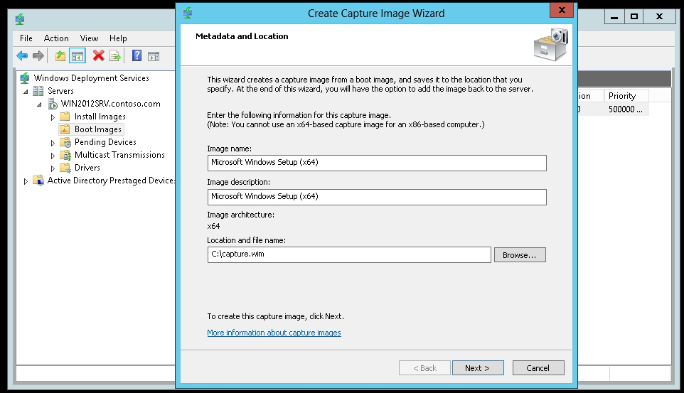
Create an Image File-I
Specifying the location and file name
© 2013 John Wiley & Sons, Inc.

Slide 38
Microsoft System Preparation Utility
Sysprep.exe prepares a Windows computer for cloning by removing specific computer information such as the computer name and Security Identifier (SID).
On Windows Server 2012, Sysprep.exe is located in C:\Windows\System32\Sysprep
When running sysprep on the master computer, use the following syntax:
sysprep /generalize /oobe
© 2013 John Wiley & Sons, Inc.

Slide 39
Creating a
Discover Image
On computers that do not support a PXE boot, you can boot the computer from disk using a discover image.
A discover image is an image file that you can burn to a CD-ROM or other boot medium.
© 2013 John Wiley & Sons, Inc.

Slide 40
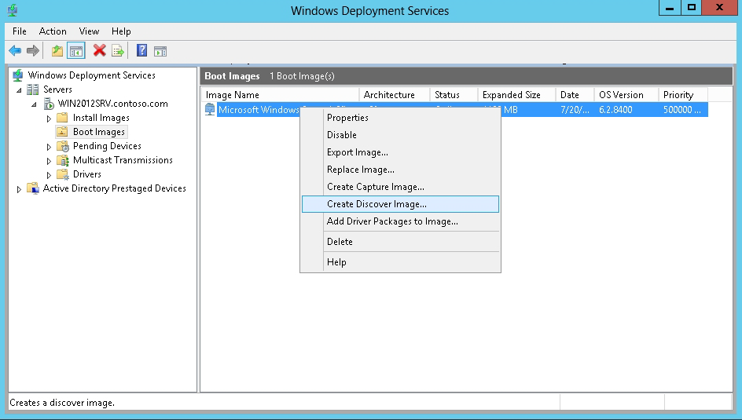
Create a Discover Image
Creating a discover image
© 2013 John Wiley & Sons, Inc.

Slide 41
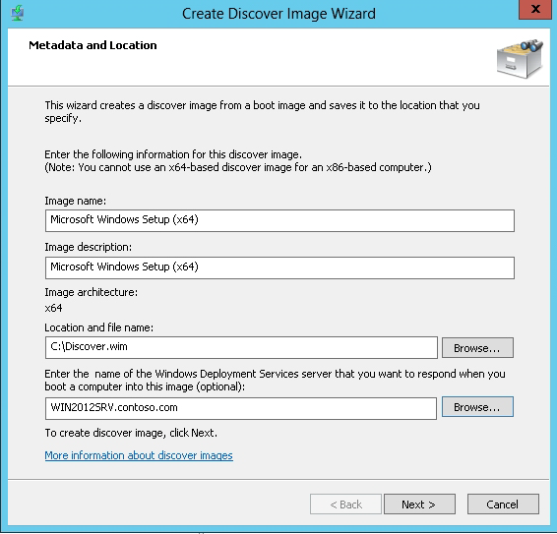
Create a Discover Image-I
Specifying the image name, the image description, and where to store the discover image file
© 2013 John Wiley & Sons, Inc.

Slide 42
Windows Assessment and Deployment Kit (ADK)
To convert a discover image to a bootable .ISO image, first download and install the ADK for Windows 8.
ADK is a set of tools provided by Microsoft to customize, assess, and deploy a Windows operating system to new computers.
© 2013 John Wiley & Sons, Inc.

Slide 43
Create a Bootable
ISO Image
Create a bootable ISO by running the following command:
  oscdimg -b"c:\WinPE_X64\etfsboot.com” -n C:\WinPE_X64\ISO C:\ WinPE_X64\WinPE_X64.iso
© 2013 John Wiley & Sons, Inc.

Slide 44
Performing an
Unattended Installation
Use answer files to provide responses to the prompts that normally appear during the Windows installation.
Create answer files with:
  A text editor
  An XML editor
  System Image Manager (SIM), a tool used to create and manage unattended Windows setup answer files using a graphical interface
© 2013 John Wiley & Sons, Inc.

Slide 45
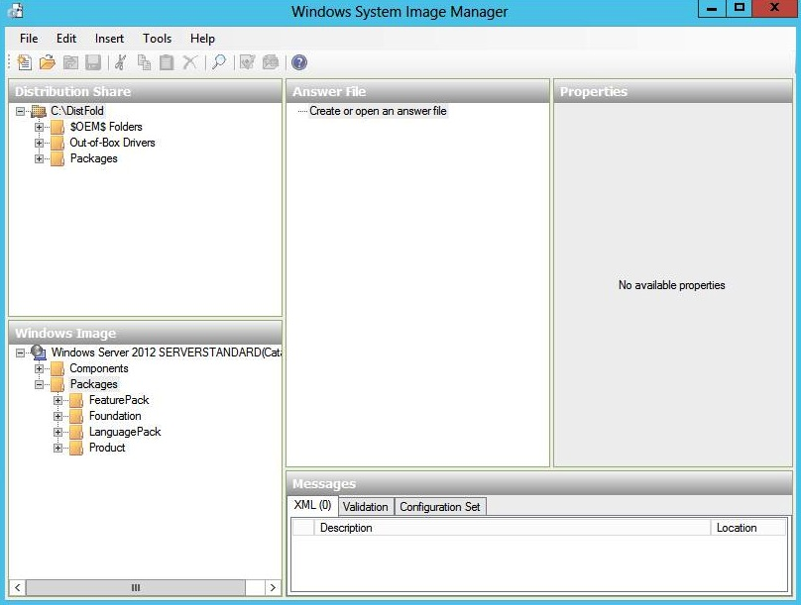
Create an Answer File
Viewing the distribution share subfolders in the Distribution Share pane
© 2013 John Wiley & Sons, Inc.

Slide 46
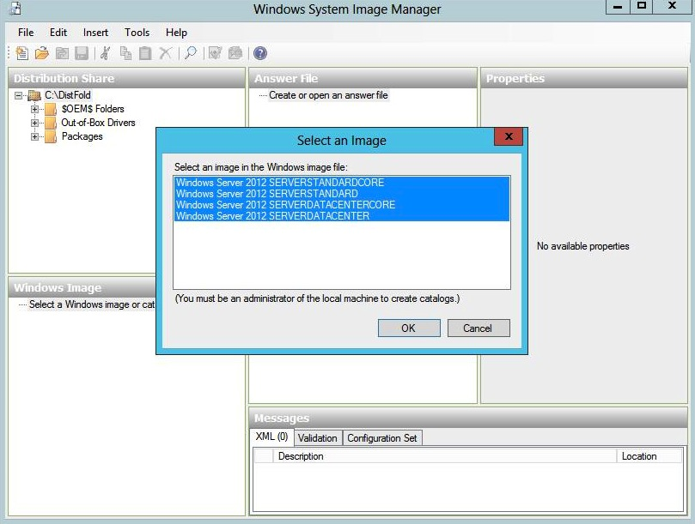
Create an Answer File-I
Selecting an Image
© 2013 John Wiley & Sons, Inc.

Slide 47
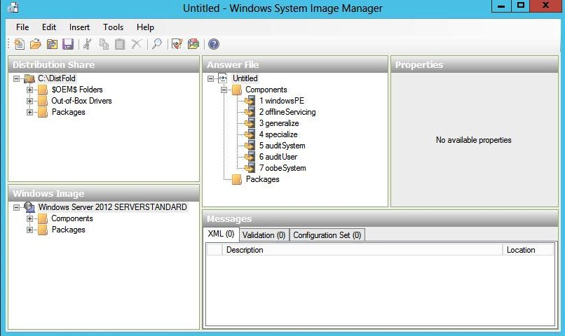
Create an Answer File-II
Viewing elements in the Answer File pane
© 2013 John Wiley & Sons, Inc.

Slide 48
Seven Configuration Passes in an Answer File
windowsPE
offlineServicing
generalize
specialize
auditSystem
auditUser
oobeSystem
© 2013 John Wiley & Sons, Inc.

Slide 49
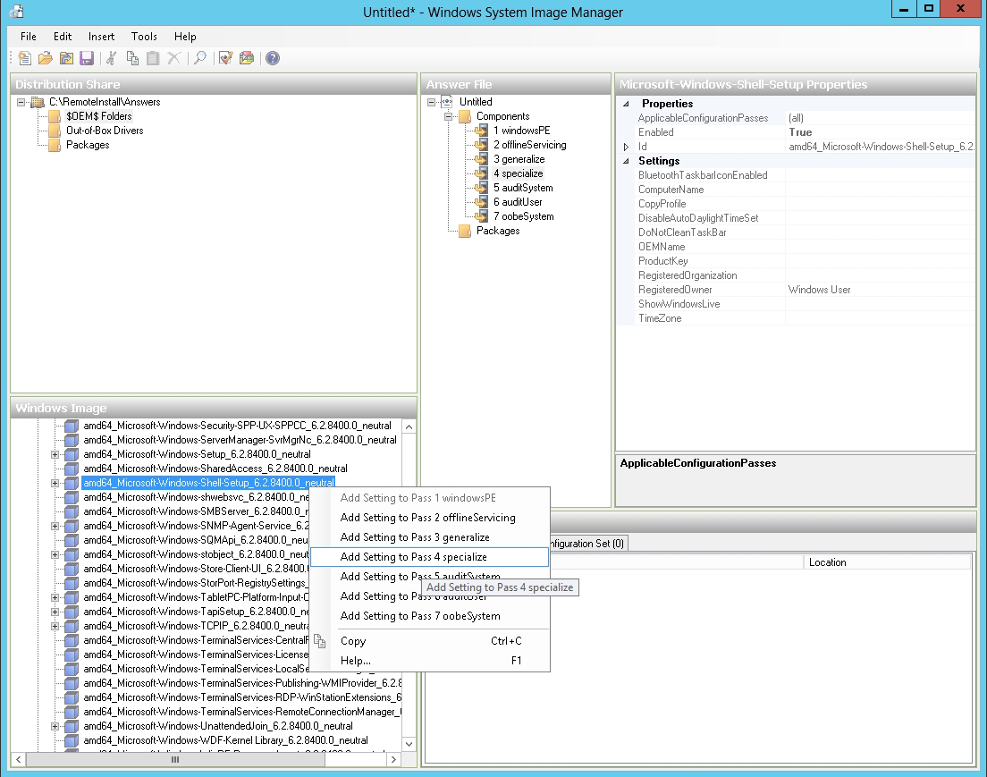
Create an Answer File-III
Selecting a configuration pass
© 2013 John Wiley & Sons, Inc.

Slide 50
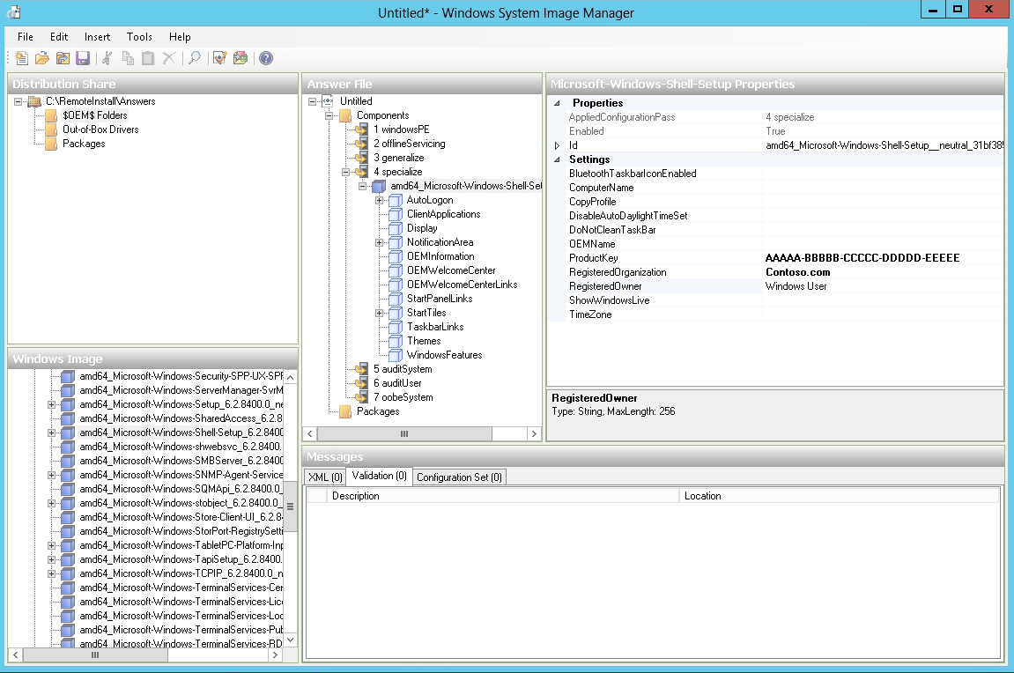
Create an Answer File-IV
Configuring setting properties
© 2013 John Wiley & Sons, Inc.

Slide 51
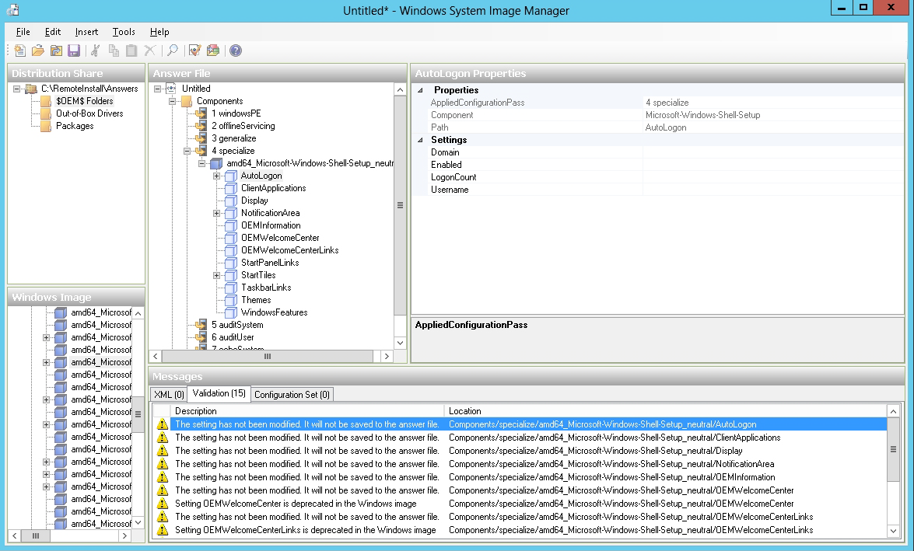
Create an Answer File-V
Validating an answer file
© 2013 John Wiley & Sons, Inc.

Slide 52
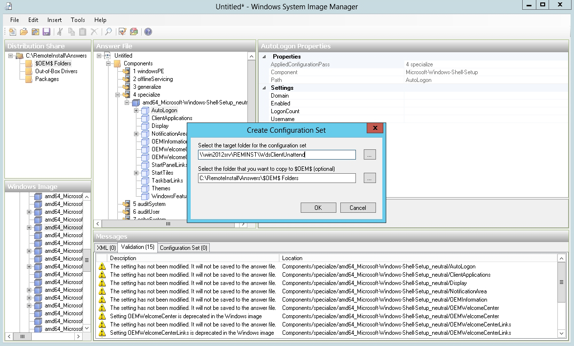
Create an Answer File-VI
Creating a configuration set
© 2013 John Wiley & Sons, Inc.

Slide 53
Unattend Files
To install an operating system on a client using WDS with no interactivity, you must have these two unattend files:
WDS client unattend file: Automates the WDS client procedure that begins when the client computer loads the boot image file
Operating system unattend file: For a standard operating system installation; contains responses to all prompts that display after the client computer loads the install image file
© 2013 John Wiley & Sons, Inc.

Slide 54
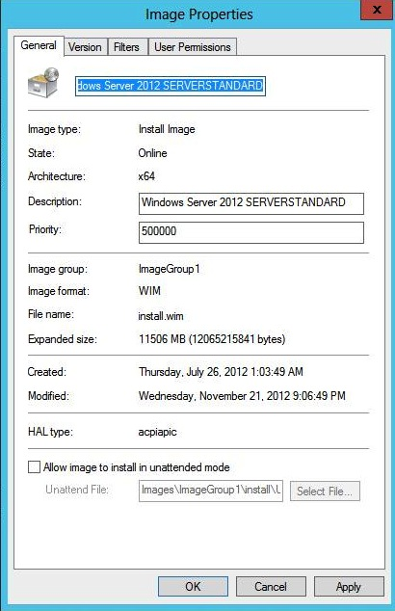
Deploy a Server Using an Unattend File
Viewing the Image Properties dialog box
© 2013 John Wiley & Sons, Inc.

Slide 55
Patches, Hotfixes, and Drivers
Using the dism command:
  To make changes to an image, mount the Windows image in the Windows file structure using the Mount-Wim option.
  After you make changes to the image, commit the changes by using the /Commit-Wim option.
  To unmount the image, use the /Unmount-Wim option.
  To get information about an image or WIM file, use the
  /Get-WimInfo option.
© 2013 John Wiley & Sons, Inc.

Slide 56
Patches, Hotfixes, and Drivers
If a Windows package is provided as a cabinet (.cab) file or as a Windows Update Stand-alone Installer (.msu) file, you can add the package using the /Add-Package command. For example:
  Dism /image:C:\offline /Add-Package /Packagepath:C:\Update\Update.cab
To remove a package, use the
  /Remove-Package option.
© 2013 John Wiley & Sons, Inc.

Slide 57
Installing Features for
Offline Images
Deployment Image Servicing and Management (Dism.exe) is a command-line tool that can be used to service a Windows image or to prepare a Windows PE image.
With Dism, you can mount an image offline and then add, remove, update, or list the features, packages, drivers, or international settings stored on that image.
Dism.exe is not included with Windows.
© 2013 John Wiley & Sons, Inc.

Slide 58
Deploying Driver Packages with an Image
Using dynamic driver provisioning requires:
  The boot image from either Windows 7, Windows 8, Windows Server 2008 R2, or Windows Server 2012 (from \Sources\Boot.wim on the DVD)
  The install images for Windows Vista SP1, Windows 7, Windows 8, Windows Server 2008, Windows 7, Windows Server 2008 R2, or Windows Server 2012
To deploy drivers based on the plug-and-play hardware of the client, you must extract the drives; they cannot be an .msi file or an .exe file.
© 2013 John Wiley & Sons, Inc.

Slide 59
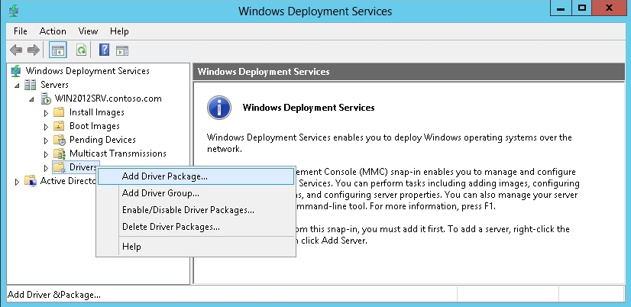
Add Drivers to an Image
Selecting the Add Driver Package option
© 2013 John Wiley & Sons, Inc.

Slide 60
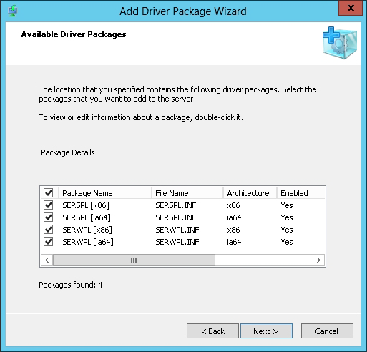
Add Drivers to an Image-I
Selecting driver packages
© 2013 John Wiley & Sons, Inc.

Slide 61
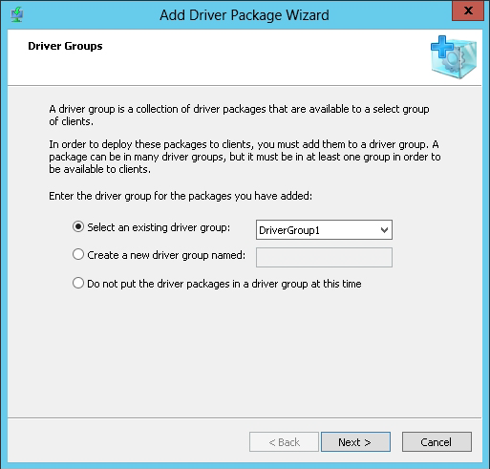
Add Drivers to an Image-II
Selecting a driver group
© 2013 John Wiley & Sons, Inc.

Slide 62
Lesson Summary
Windows Deployment Services (WDS) is a software platform and technology that allows administrators to perform automated network-based installations based on network-based boot and installation media.
For client computers to communicate with a WDS server without an operating system, the client computer must support the preboot execution environment (PXE).
Windows Preinstallation Environment (Windows PE) is a minimal Windows operating system with limited services.
Before you can use WDS, you must configure WDS server.
To deploy Windows, you must create a boot image and an install image.
© 2013 John Wiley & Sons, Inc.

Slide 63
Lesson Summary-I
The Microsoft System Preparation Utility (Sysprep.exe) prepares a Windows computer for cloning by removing specific computer information such as the computer name and Security Identifier (SID).
A computer that does not support a PXE boot can boot from a disk using a discover image.
To streamline the installation process, you must automate the Windows installation by using answer files, which provide responses to the prompts that would normally display during the Windows installation.
Deployment Image Servicing and Management (Dism.exe) is a command-line tool that can be used to service a Windows image or to prepare a Windows PE image.
© 2013 John Wiley & Sons, Inc.

Slide 64
Copyright 2013 John Wiley & Sons, Inc.
All rights reserved. Reproduction or translation of this work beyond that named in Section 117 of the 1976 United States Copyright Act without the express written consent of the copyright owner is unlawful. Requests for further information should be addressed to the Permissions Department, John Wiley & Sons, Inc. The purchaser may make back-up copies for his/her own use only and not for distribution or resale. The Publisher assumes no responsibility for errors, omissions, or damages, caused by the use of these programs or from the use of the information contained herein.

